Slide 1
Big Data Final PROJECT
Group Member:
Hongyong Zhang/Ruinong Tian/Shouzhe Zhang/Wei Luo/Yiwen Wang

Slide 2
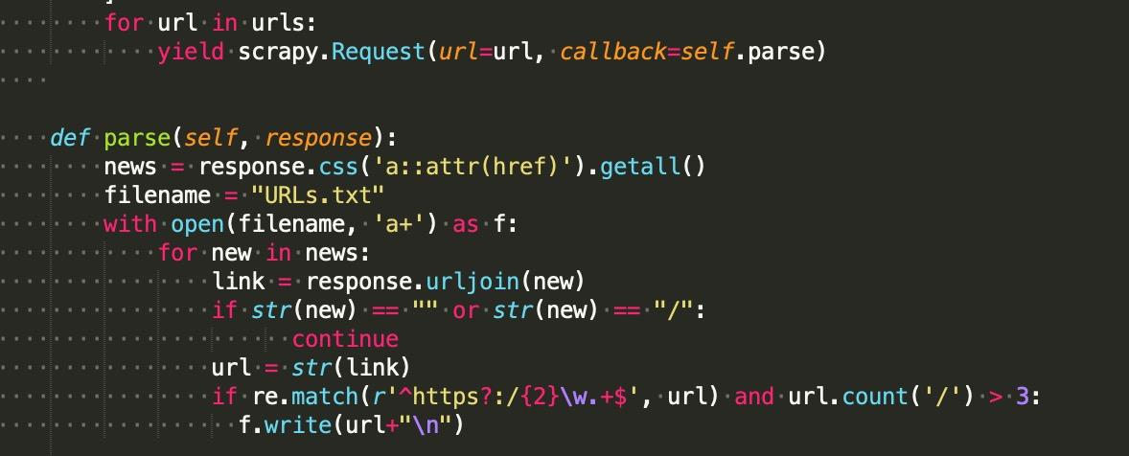
Step 1
Scrapy urls from seed
Analyze webpage, find out all pages containing news’ URL
Crawl & Filter all possible URL

Slide 3
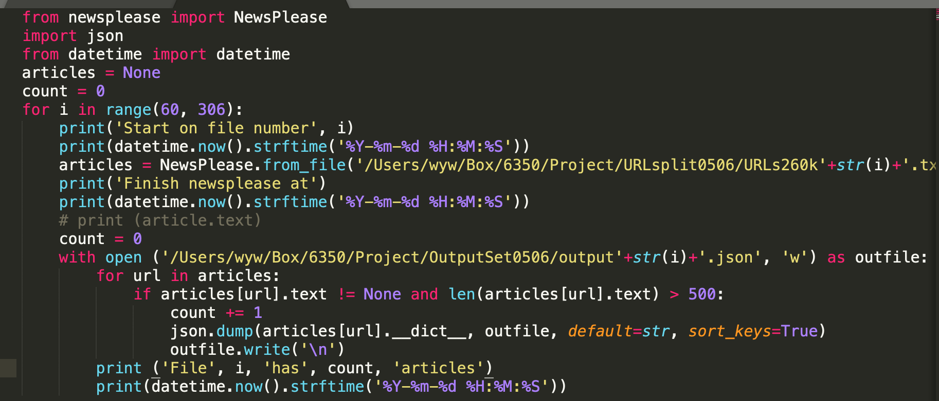
Step 2
Crawling Spanish news on 150, 000 urls using news-please

Slide 4
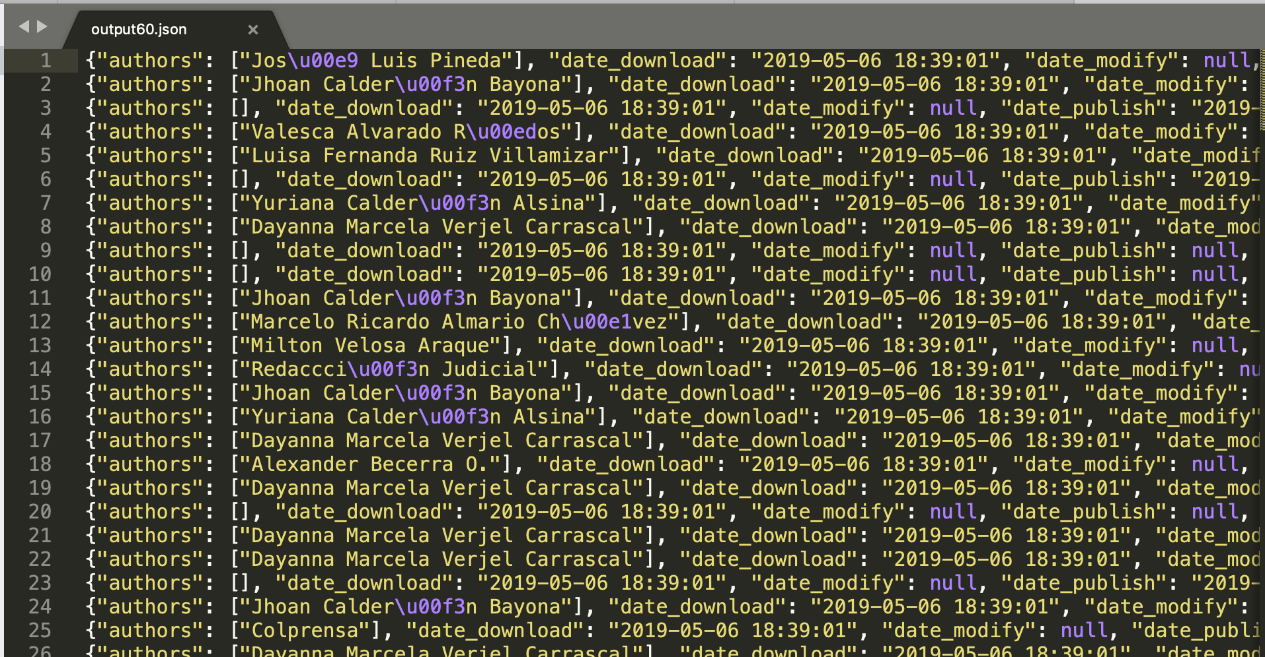
Step 2
Crawling Spanish news on 150, 000 urls using news-please

Slide 5
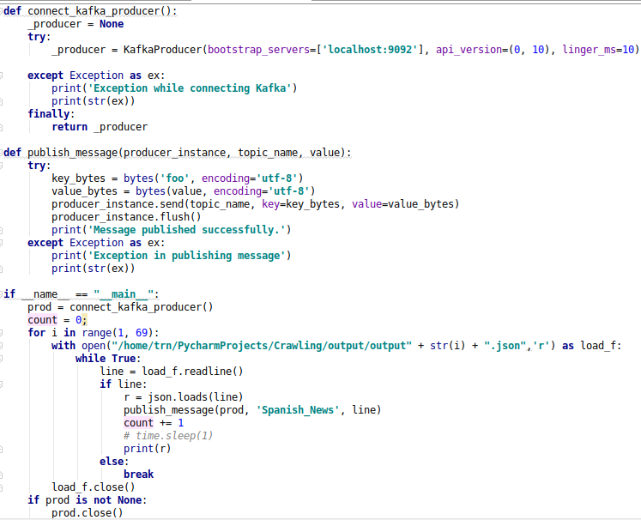
Step 3
producer:
Read json format extracted news content
Using kafka producer to push these content

Slide 6
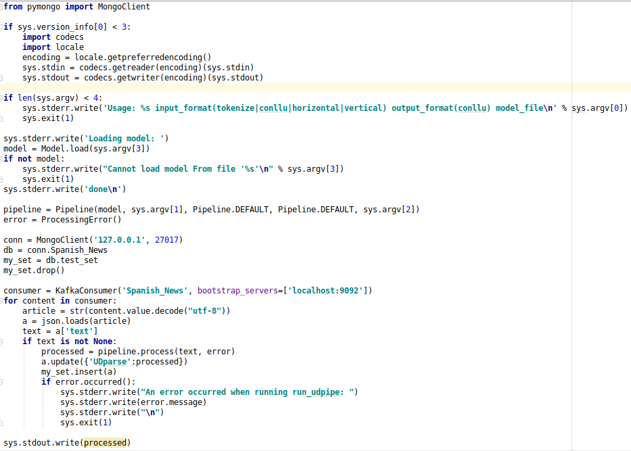
Step 4
consumer:
Generate the universal dependency of each news article using ufal.udpipe in kafka consumer
Store collected data and processed data into mongodb

Slide 7
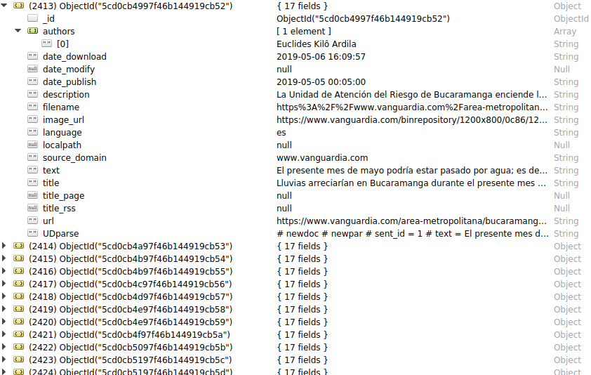
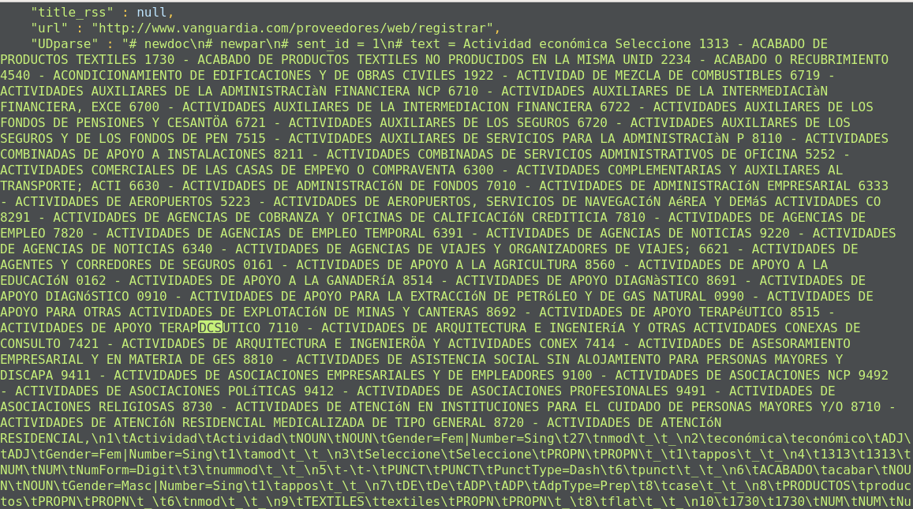
Step 4
Mongodb:
UDparse:

Slide 8
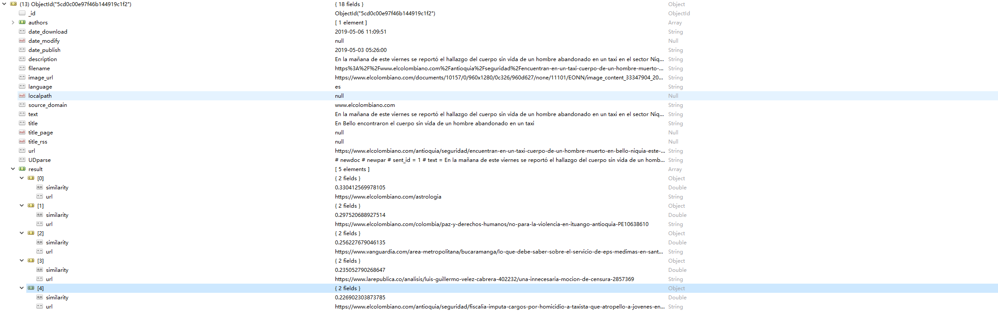
Step 5
Read content from mongodb
Running deduplication algorithm at content level

